Slide 1
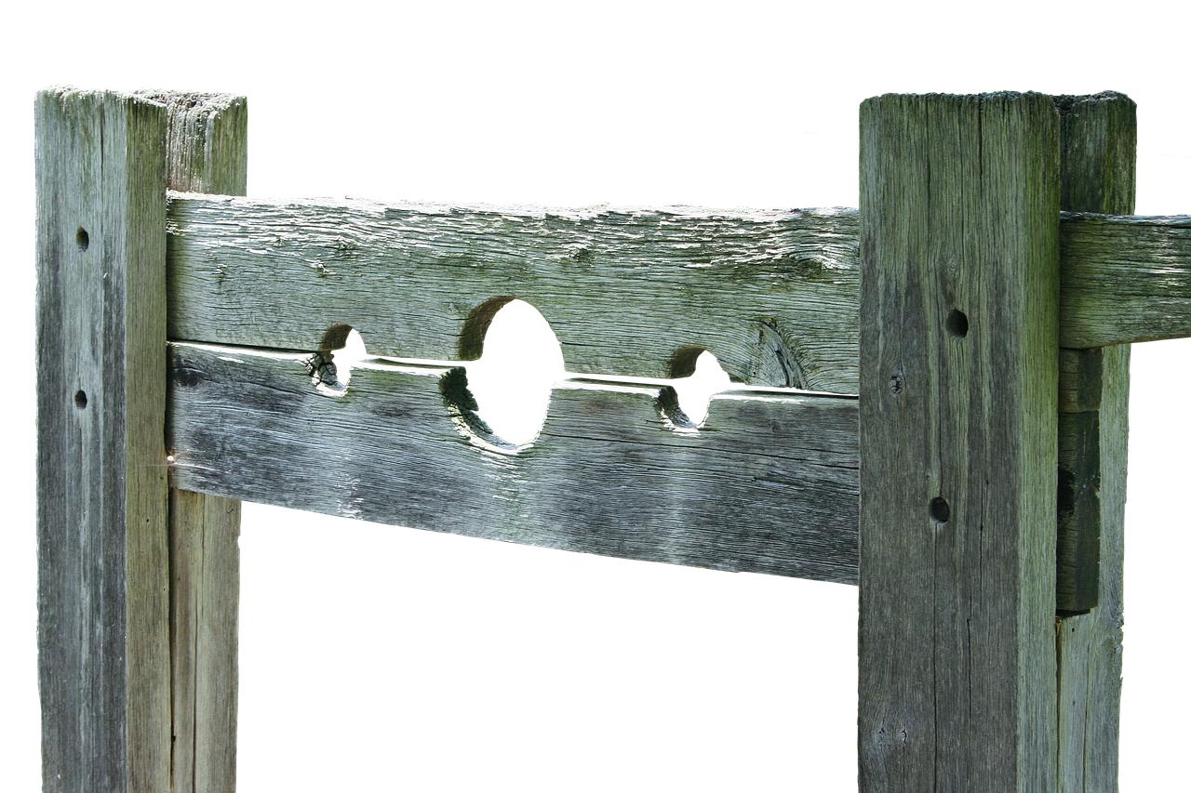
Correction & Pedagogy
Pedagogy
The method and practice of teaching
Notes:
Don’t forget to download font (Good Brush) to pulpit computer.
Scripture for reading?
Regarding the image.
I am not advocating that people be put into stocks.
(Hard to find an image that is memorable and makes the point that chastisement is a legitimate and effective tool in teaching. The Bible affirms that it is).
Maybe by using this Image, the lesson will stick in our minds.
[CLICK] Regarding the word Pedagogy
Definition – the method and practice of teaching
So, why not just say teaching?
The word is actually from the Greek, and in form is found in scripture!
(Galatians 3:27), “Therefore the law was our tutor (pedagogue) to bring us to Christ, that we might be justified by faith. ²⁵ But after faith has come, we are no longer under a tutor (pedagogue)”
From Greek pais (a boy) and ago (to lead) Hence, to lead or to teach a boy.
Plus, it is more memorable, so maybe again will help this lesson to stick in your minds.
Our question for today
Is correction (a term we will define from scripture) the legitimate and effective tool in teaching that we affirm it is?
Let’s see if we can answer that question by making our appeal from God’s word.

Slide 2
Correction – A Biblical Definition
“The idea of chastisement was very closely connected in the Hebrew mind with that of pedagogy” (ISBE)
(Hebrew – mūsār; shēbhet)
(Greek – epanórthōsis)
“The difference between correction, discipline and instruction was not clearly drawn in the Hebrew mind” (ISBE)
Notes:
First, let’s define what we intend in using the word Correction:
The ISBE states in its entry on the term: “The idea of chastisement was very closely connected in the Hebrew mind with that of pedagogy”
Of course, the reason this is so is because their law (the Old Covenant) makes it clear that God couples chastisement with learning.
A good example of this – Nathan’s conversation with David in 2 Samuel 12 (Sin – Uriah/Bathsheba)
Nathan accused him of sinning and doing “evil in His sight” (12:9).
David confessed his guilt. “So David said to Nathan, ‘I have sinned against the Lord.’” (12:13).
God forgave Him, but he was chastised for his sin…
(12:10), “Now therefore, the sword shall never depart from your house, because you have despised Me, and have taken the wife of Uriah the Hittite to be your wife.”
(12:14), “However, because by this deed you have given great occasion to the enemies of the Lord to blaspheme, the child also who is born to you shall surely die.”
Hebrew Words which are translated Correction
musar (as illustrated in Jeremiah 7)
God called upon Judah to repent of her ungodliness
(Jeremiah 7:3), “Thus says the Lord of hosts, the God of Israel: “Amend your ways and your doings, and I will cause you to dwell in this place.”
He then called upon them to learn from the mistakes made by Israel and avoid their end
(Jeremiah 7:15), “And I will cast you out of My sight, as I have cast out all your brethren—the whole posterity of Ephraim.”
When God chastised Israel, they did not heed His correction. They “stiffened their neck.” If Judah did the same…
(Jeremiah 7:28), “So you shall say to them, ‘This is a nation that does not obey the voice of the Lord their God nor receive correction. Truth has perished and has been cut off from their mouth.’”
musar - properly chastisement; figuratively reproof, warning or instruction; also restraint: - bond, chastening ([-eth]), chastisement, check, correction, discipline, doctrine, instruction, rebuke.
Shebhet – Job 21:9 refers to the “rod of God”
(Job 37:13), [Referring to God’s providential power seen in nature. Specifically, Weather], “He causes it to come, whether for correction, or for His land, or for mercy.”
shebhet - Literally, - refers to a stick (Hence rod). In our context, used for instruction/correction/chastisement
Greek word translated Correction
epanorthosis
(2 Timothy 3:16-17), “All Scripture is given by inspiration of God, and is profitable for doctrine, for reproof, for correction, for instruction in righteousness, ¹⁷ that the man of God may be complete, thoroughly equipped for every good work.”
Note the inverse here. Correction (in the sense of chastisement) can be helpful in teaching. Here, God’s word (the instrument of teaching) can be used to bring correction!
epanorthosis - 1) restoration to an upright or right state; 2) correction, improvement of life or character
Our emphasis in this lesson is the former. That scripture indicates correction, chastisement, discipline can be helpful in teaching and reforming us.
This is why the ISBE says, “The difference between correction, discipline and instruction was not clarly drawn in the Hebrew mind.”
This is so because God utilizes correction to establish truths in the hearts of man, and to reform their lives.

Slide 3
Correction & Pedagogy (Teaching)
God corrects & teaches his people
Deut. 8:1-5; Prov. 3:11-12; Heb. 5:5-11
Parents are to correct & teach their children
Heb. 12:7-11; Prov. 22:15; 23:13-14; 29:15
Churches are to correct & teach members
Rom. 15:14; 1 Thess. 5:12-13; 2 Thess. 3:13-15
Notes:
God chastises for the correction and instruction of his people (Both Israel and Us)
Consider the example of Israel, (Moses’ instruction as he reviewed with the people the 10 commandments).
(Deuteronomy 8:1-5), “Every commandment which I command you today you must be careful to observe, that you may live and multiply, and go in and possess the land of which the Lord swore to your fathers. ² And you shall remember that the Lord your God led you all the way these forty years in the wilderness, to humble you and test you, to know what was in your heart, whether you would keep His commandments or not. ³ So He humbled you, allowed you to hunger, and fed you with manna which you did not know nor did your fathers know, that He might make you know that man shall not live by bread alone; but man lives by every word that proceeds from the mouth of the Lord. ⁴ Your garments did not wear out on you, nor did your foot swell these forty years. ⁵ You should know in your heart that as a man chastens his son, so the Lord your God chastens you.”
It shows his love for man
(Proverbs 3:11-12), “My son, do not despise the chastening of the Lord, nor detest His correction; ¹² For whom the Lord loves He corrects, just as a father the son in whom he delights.”
The chastening of God continues under Christ’s covenant as well! Because God’s love for man remains.
(Hebrews 5:5-11), “So also Christ did not glorify Himself to become High Priest, but it was He who said to Him: “You are My Son, Today I have begotten You.” ⁶ As He also says in another place: “You are a priest forever according to the order of Melchizedek”; ⁷ who, in the days of His flesh, when He had offered up prayers and supplications, with vehement cries and tears to Him who was able to save Him from death, and was heard because of His godly fear, ⁸ though He was a Son, yet He learned obedience by the things which He suffered. ⁹ And having been perfected, He became the author of eternal salvation to all who obey Him, ¹⁰ called by God as High Priest “according to the order of Melchizedek,” ¹¹ of whom we have much to say, and hard to explain, since you have become dull of hearing.”
One important note: If we correct ourselves, there is no need for God’s chastisement!
1 Corinthians 11:31-32), [Regarding eating the L.S. in a worthy manner], “For if we would judge ourselves, we would not be judged. ³² But when we are judged, we are chastened by the Lord, that we may not be condemned with the world.”
[CLICK] Parents are to chastise for correction and instruction of their children (Physical chastisement included)
(Hebrews 12:7-11), “If you endure chastening, God deals with you as with sons; for what son is there whom a father does not chasten? ⁸ But if you are without chastening, of which all have become partakers, then you are illegitimate and not sons. ⁹ Furthermore, we have had human fathers who corrected us, and we paid them respect. Shall we not much more readily be in subjection to the Father of spirits and live? ¹⁰ For they indeed for a few days chastened us as seemed best to them, but He for our profit, that we may be partakers of His holiness. ¹¹ Now no chastening seems to be joyful for the present, but painful; nevertheless, afterward it yields the peaceable fruit of righteousness to those who have been trained by it.”
BTW, regardless of present views of psychologists and “experts” I know this because…
Scriptures tell me so
(Proverbs 22:15), “Foolishness is bound up in the heart of a child; the rod of correction will drive it far from him.”
(Proverbs 23:13-14), “Do not withhold correction from a child, for if you beat him with a rod, he will not die. ¹⁴ You shall beat him with a rod, and deliver his soul from hell.”
I know it from personal experience, and the testimony of my own children
The goal of punishment
To bring about a change in behavior (to teach!)
(Proverbs 29:15), “The rod and rebuke give wisdom, but a child left to himself brings shame to his mother.”
Chastisement brings sorrow (hurt feelings). This is a good thing when it brings about change!
BTW, not talking solely of spanking as physical punishment. There are other tools!
Rebuke
Confiscation of goods or privileges (take away allowance or game privileges, or phone)
Repayment (damage done, pay for broken window, etc.)
Shame (expression of disappointment. Requiring public apology, etc.)
Imprisonment (time out, grounding)
Banishment! (Ex: how would you react to a child who goes off to college, supported by parents, then moves in with girlfriend or boyfriend? Would it not be appropriate to completely cut off support?
Artexerxes (King of Persia) understood the nature of these punishments, calling upon the Jews who he allowed back in the promised land to obey their God (his letter to Ezra).
(Ezra 7:26), “Whoever will not observe the law of your God and the law of the king, let judgment be executed speedily on him, whether it be death, or banishment, or confiscation of goods, or imprisonment.”
Parents, remember that such chastisement should be just, consistent and prompt (Frustration otherwise)
(Ephesians 6:4), “And you, fathers, do not provoke your children to wrath, but bring them up in the training and admonition of the Lord.”
[CLICK] Churches are to chastise their members for correction and instruction (discipline)
Admonition (to call attention to “sin” to rebuke mildly) is an important expression of love for your brother or sister
(Romans 15:14), “Now I myself am confident concerning you, my brethren, that you also are full of goodness, filled with all knowledge, able also to admonish one another.”
Such admonition is a work of the eldership. When it is done (bringing one to repentance) it is an esteemed work.
(1 Thessalonians 5:12-13), “And we urge you, brethren, to recognize those who labor among you, and are over you in the Lord and admonish you, ¹³ and to esteem them very highly in love for their work's sake. Be at peace among yourselves.”
Bringing attention to sin brings shame to the sinner. Shame is a good thing! It leads to repentance!
(2 Thessalonians 3:13-15), “But as for you, brethren, do not grow weary in doing good. ¹⁴ And if anyone does not obey our word in this epistle, note that person and do not keep company with him, that he may be ashamed. ¹⁵ Yet do not count him as an enemy, but admonish him as a brother.”
As it did with the Corinthians.
(2 Corinthians 7:11), “For observe this very thing, that you sorrowed in a godly manner: What diligence it produced in you, what clearing of yourselves, what indignation, what fear, what vehement desire, what zeal, what vindication! In all things you proved yourselves to be clear in this matter”

Slide 4
Conclusion
“Now no chastening seems to be joyful for the present, but painful; nevertheless, afterward it yields the peaceable fruit of righteousness to those who have been trained by it.” (Hebrews 12:11)
May we all be ready to receive the Lord’s corrections!
Notes:
Conclusion
In our society’s “Americanized” version of Christianity, the idea of making someone feel bad about themselves is deemed by many to be completely unacceptable!
To Christians in the first century, it was a natural response to sin!
While not pleasant, it is beneficial and needed for our spiritual welfare!
(Hebrews 12:11), “Now no chastening seems to be joyful for the present, but painful; nevertheless, afterward it yields the peaceable fruit of righteousness to those who have been trained by it.
May we all be ready to receive the Lord’s corrections!

